Slide 1
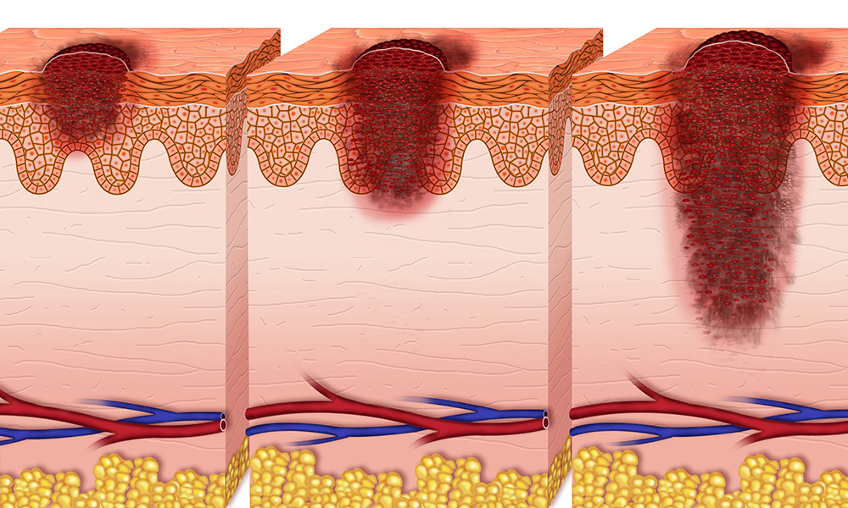
MULTI-CLASS CLASSIFICATION OF SKIN DISEASES

Slide 2

Group 3 members
Antony Kanai
Brenda Kinoti
Jared Bii
Leah George
Phelix Okumu
Sharon Kimutai
Janet Khainza

Slide 3

Project Scope

Slide 4
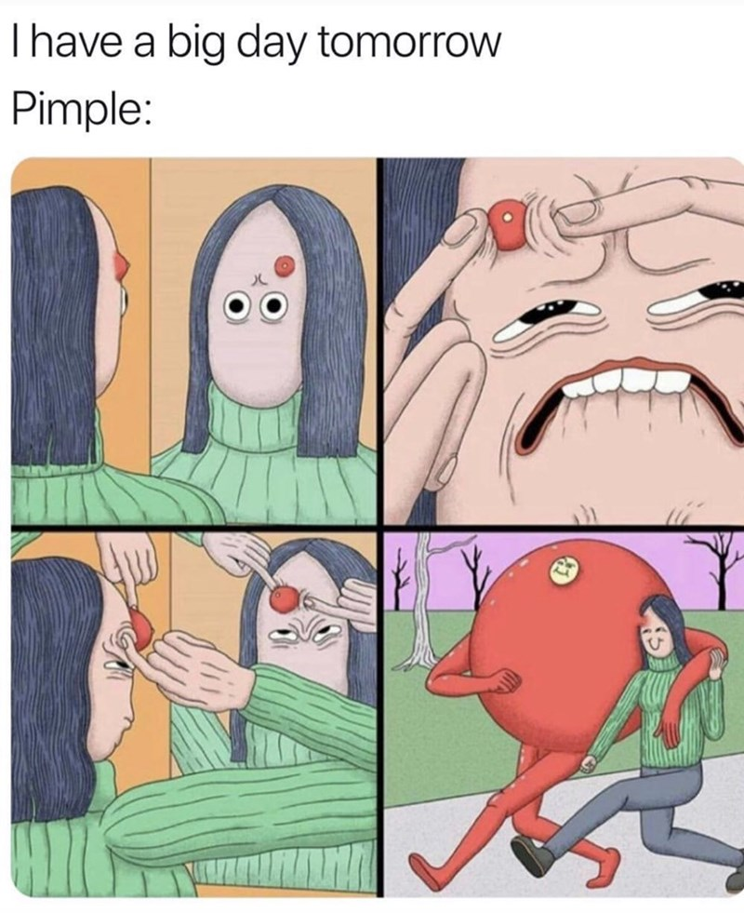

Slide 5
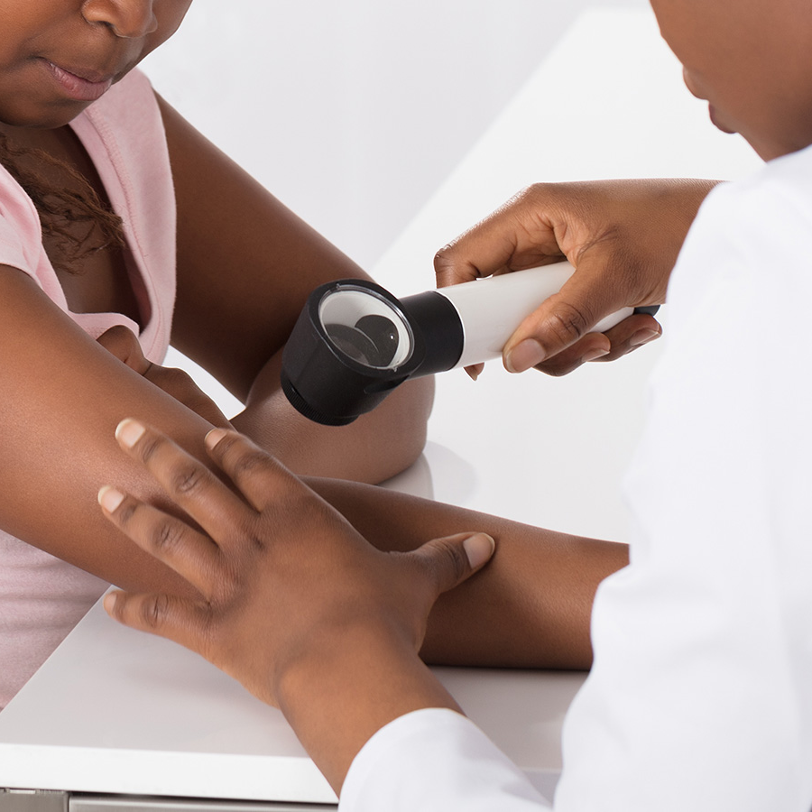
Business Understanding
Skin diseases can vary widely, impacting overall health, and some, like skin cancer can be life-threatening.
Early and accurate identification of the types of skin diseases is of great importance.
Cutting edge technologies can revolutionize dermatological diagnostics, enhancing efficiency, reducing errors, and ultimately improving patient outcomes.
Notes:
Skin diseases are a serious issue due to their prevalence, impact on individuals' quality of life, and associated healthcare costs. Let's explore this with statistics:
1. **High Prevalence:**
- According to the World Health Organization (WHO), skin diseases are extremely common, affecting millions of people worldwide.
- Skin diseases rank as the fourth leading cause of non-fatal disease burden globally, based on data from the Global Burden of Disease Study.
2. **Economic Burden:**
- Skin diseases impose a significant economic burden on healthcare systems and individuals. In the United States, the direct healthcare costs associated with skin diseases are estimated to be in the billions annually.
3. **Impact on Mental Health:**
- Skin diseases can have a profound impact on mental health. For example, a survey published in JAMA Dermatology found that adults with common skin conditions, such as eczema and acne, are at a higher risk of anxiety and depression.
4. **Work and Social Life:**
- Skin diseases can affect an individual's ability to work and socialize. According to the American Academy of Dermatology, skin diseases can be a significant barrier to employment and can lead to social isolation.
5. **Cancer Prevalence:**
- Skin cancer, including melanoma and non-melanoma types, is a serious concern. The American Cancer Society estimates that in the United States, there will be over 5 million new cases of skin cancer diagnosed each year.
6. **Global Impact:**
- Skin diseases affect people of all ages and backgrounds. They are a global health issue, with varying prevalence rates in different regions. In many countries, skin diseases are a leading cause of years lived with disability (YLD).
7. **Chronic Conditions:**
- Some skin diseases, like psoriasis, eczema, and vitiligo, are chronic conditions that require ongoing management and care. The long-term nature of these diseases adds to their seriousness.
8. **Racial and Ethnic Disparities:**
- Skin diseases can disproportionately affect individuals from specific racial and ethnic backgrounds. For example, some skin conditions are more common among individuals with darker skin tones.
9. **Risk of Complications:**
- Certain skin diseases, if left untreated, can lead to complications such as infections, scarring, and, in the case of skin cancer, life-threatening consequences.
10. **Cost of Treatment:**
- The cost of treating some skin diseases can be substantial. For instance, treatment for severe psoriasis can include biologic drugs, which are among the most expensive medications available.
In summary, skin diseases are a serious issue due to their widespread prevalence, the economic burden they place on healthcare systems and individuals, and their significant impact on mental health, social well-being, and overall quality of life. Preventive measures, early diagnosis, and accessible treatment options are vital in addressing this global health concern.

Slide 6
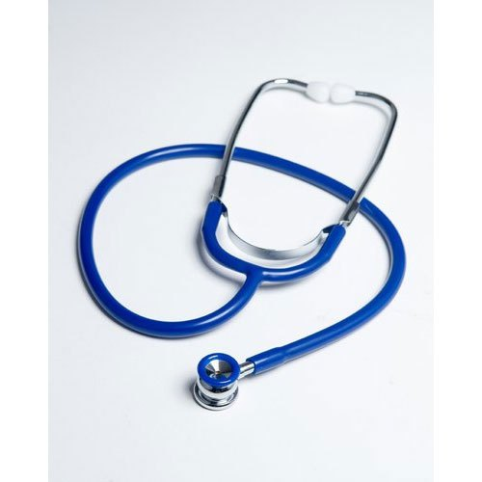
Problem Statement
Dermatologists at Flatter Dermatological Clinic struggle with accurately categorizing skin diseases from medical images.
Current manual inspection and personal judgment - time-consuming, prone to errors leading to delayed or inaccurate diagnoses.
This inefficiency can result in missed patterns and life-threatening consequences.

Slide 7

Objectives
Main objective: To build a convolutional neural network learning model capable of classifying the 9 different types of skin diseases with over 95% precision.
Other objectives are;
To explore the distribution of the different types/class of skin images in the dataset.
To assess the quality and consistency of images in the dataset.

Slide 8

Data Understanding
Dataset : 2357 images (Liverpool John Moore University)
2,239 images for Training
118 images for Testing
The data set contains 9 skin diseases:
Actinic keratosis, Basal cell carcinoma, Dermatofibroma, Melanoma, Nevus, Pigmented benign keratosis, Seborrheic keratosis, Squamous cell carcinoma , Vascular lesion.

Slide 9

Data Preparation
Exploratory Data Analysis: image counts, sampling per class, Class distributions, Class separation, Texture Analysis, RGB color channels and Pixel Intensity
1
Data Preprocessing – Splitting the data (Training Validation sets), Rescaling and Resizing, Dealing with imbalance and transforming images to create new, slightly altered images for training
2

Slide 10
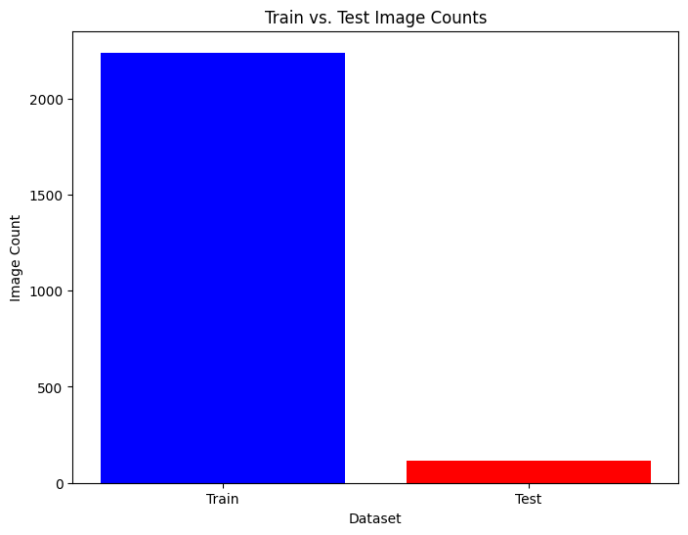
Image counts
Distribution of the skin diseases image dataset with 5% of dataset reserved for testing purposes and 95% of dataset for training the Model

Slide 11
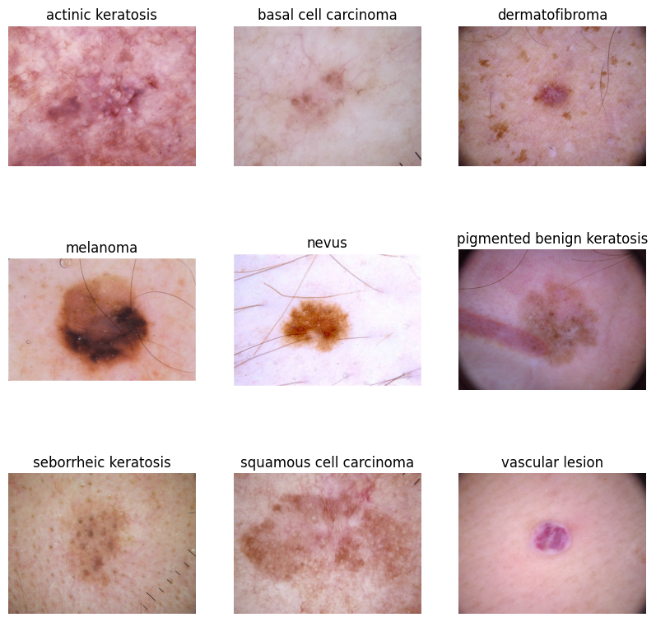
Image sample per class
This images shows a sample of image per class
The images have distinct appearance from red, pink, brown, black and purple colors
Actinic Keratosis appears as a visible rash, Melanoma appears as a dark patch and Dermatofibroma presents like tiny brownish patches.

Slide 12
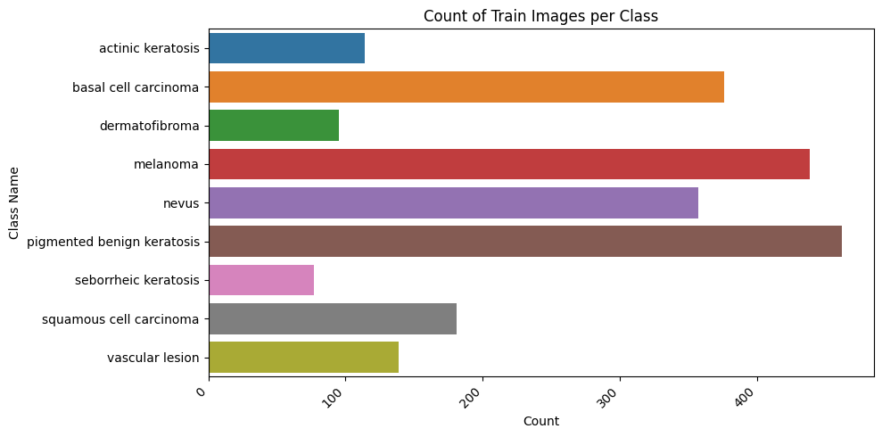
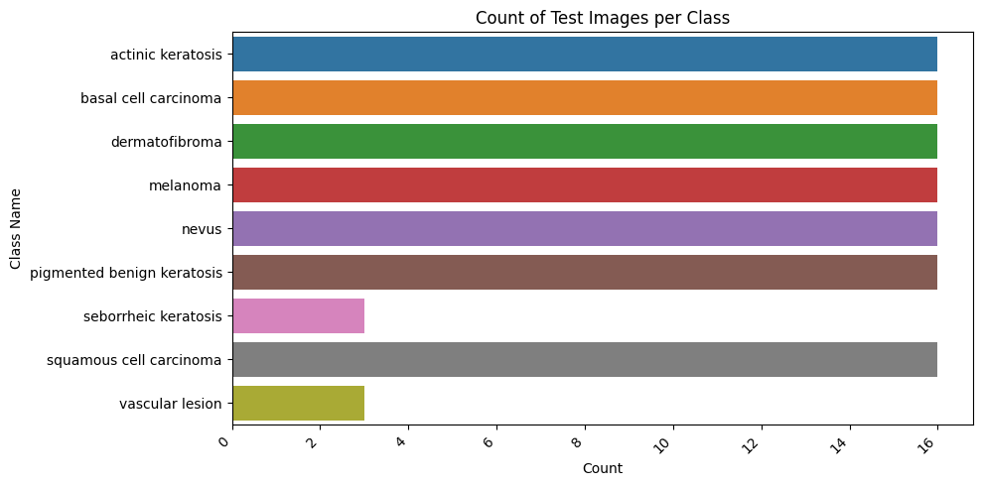
Class distribution
There is a significant class imbalance on the Train set
Majority of test set class samples are balanced.

Slide 13
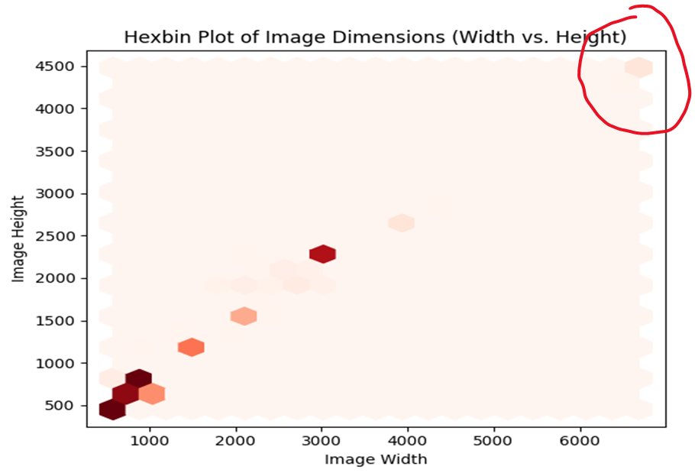
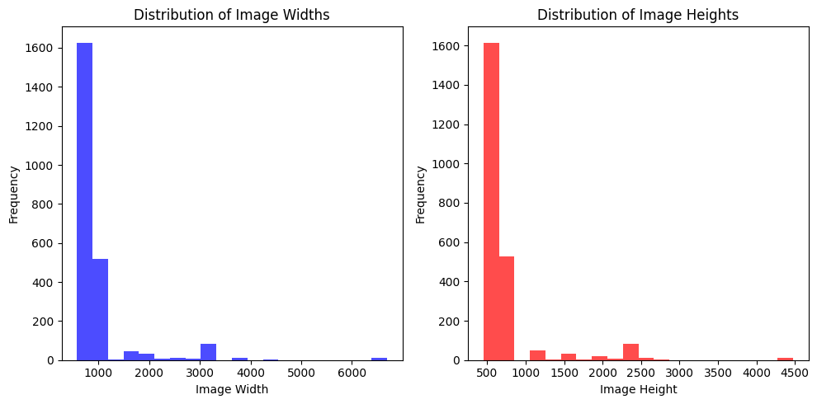
Height and Width Dimensions
Majority of images dimensions - approximately around 500 pixels in width and 450 pixels in height.
Outlier circled in red - dimensions approximately around 6500 pixels in width and 4500 pixels in height.
Standardize the image dimensions by resizing to a common size.

Slide 14
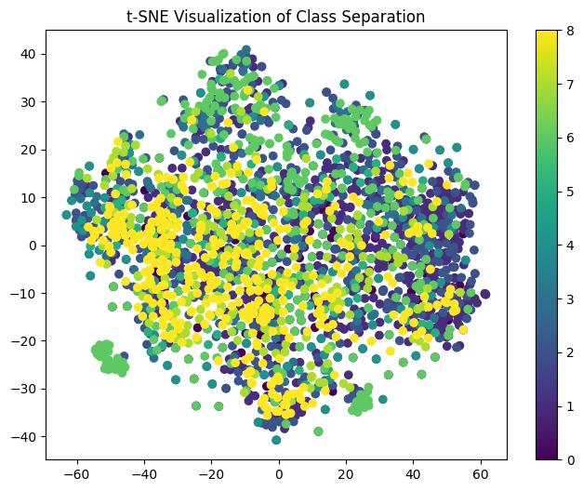
Class Separation
Absence of clear class separation - images either have complex visual characteristics or share visual similarities.
Apply augmentation to provide diverse data allowing the model to accurately distinguish between different classes.

Slide 15
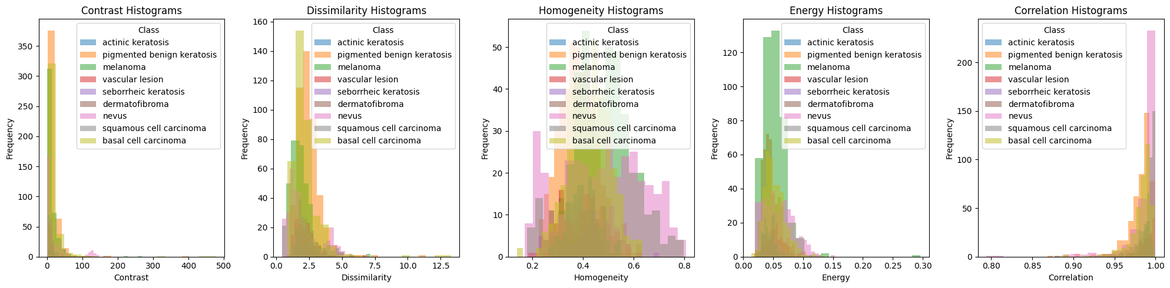
Texture Analysis
Majority of images in the classes exhibit low contrast, low dissimilarity, and low energy, indicating minimal intensity variations.
Near-normal distributed homogeneity and higher correlation suggest a uniform and consistent texture pattern within the images
Notes:
Contrast - Amount of local variations in intensity within an image from Grayscale(black and bright regions)

Slide 16
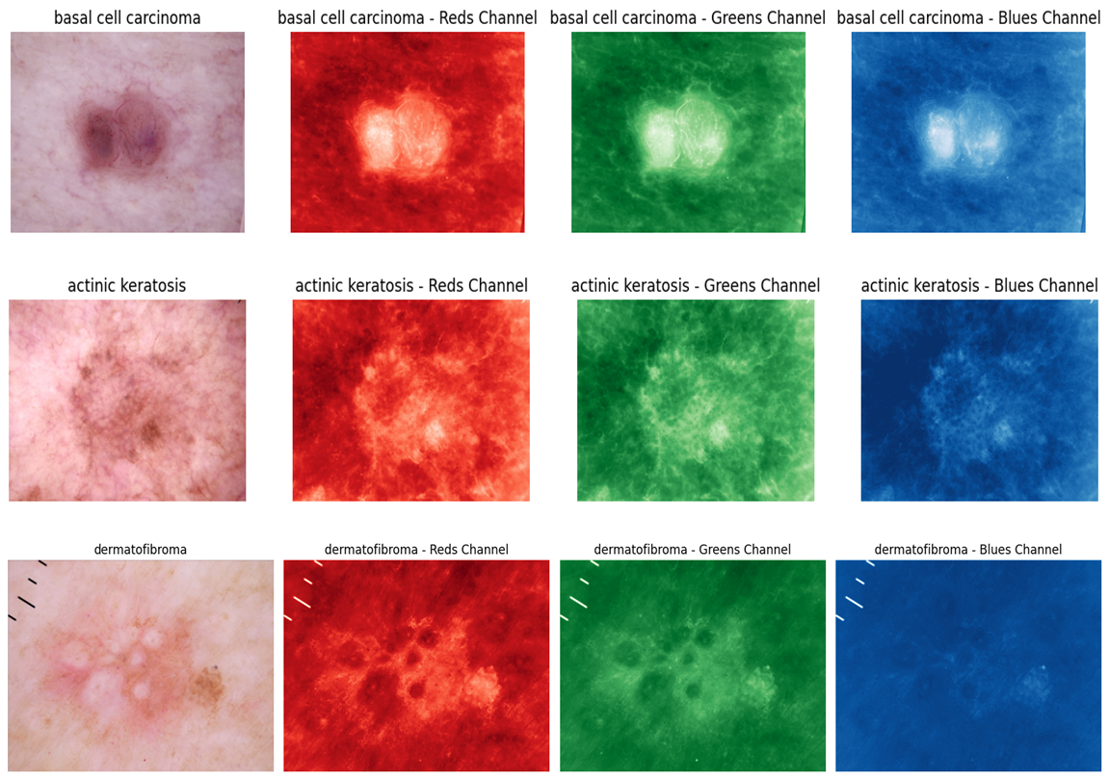
RGB Color Channels
Class images as they appears in original, red, blue and green color channels.
The images seem to be clearer on the red color channel.

Slide 17
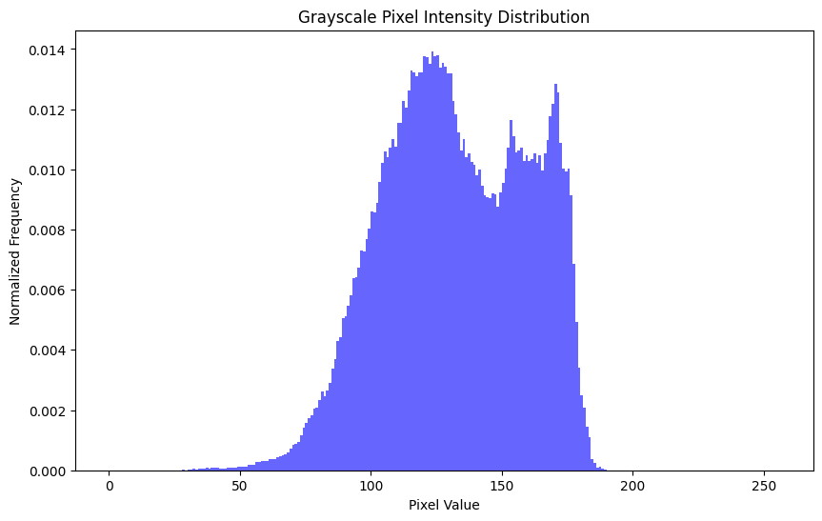
Pixel Intensity
130 is the most common pixel value in the image, representing about 1.3% of the image's pixel distribution.
Images exhibit a broad range of grayscale values, including both dark and bright regions (0-255)
Notes:
Grayscale refers to a color model in which an image is represented solely in shades of gray, ranging from black to white, with no color information

Slide 18

Modeling
Among the four models , the best performer was VGG16, a pre-trained model originally trained on a large dataset.
Model performance Improvement - Enhanced the sample size by transforming images, creating a more diverse set of samples and addressing class imbalance.
Model Evaluation – Evaluated three metrics: Precision, Accuracy and Recall. Focused on Precision

Slide 19
Model Evaluation
While the models showed relatively high-performance metrics, model3 demonstrated noticeable enhancements in precision scores and losses
Precision – Training 81.48% and Validation 73.16%

Slide 20
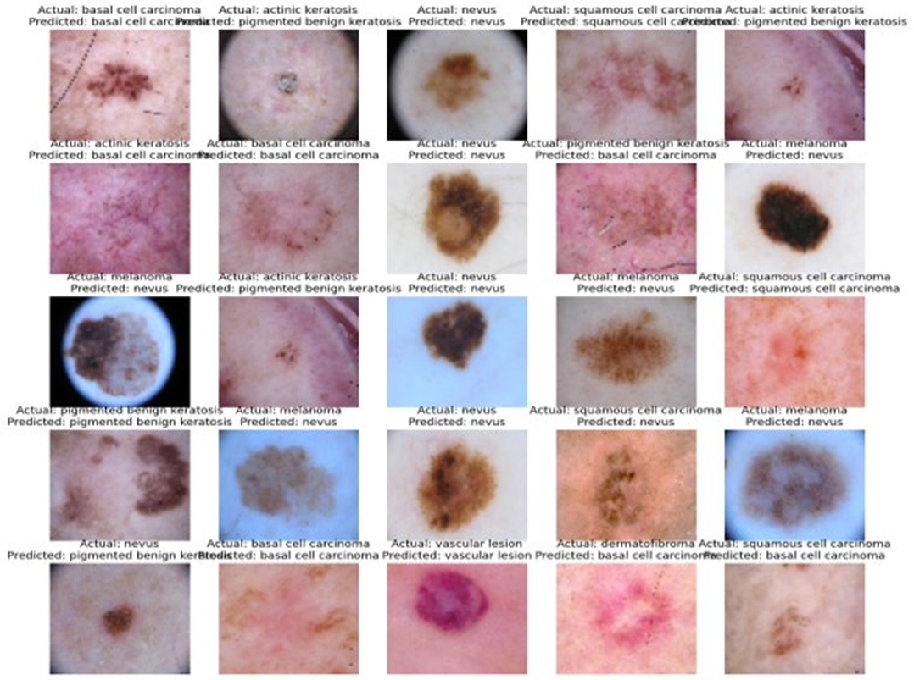
Model Predictions
The model seems to predict Nevus and Basal cell carcinoma very well, indicating high Precision in identifying these conditions.

Slide 21

Data Limitation
The skin disease images size was relatively small and could have significantly impacted the model performance
The Data may have not been from diverse geographical locations or age groups limiting the model's generalizability.
The dataset may not account for variations in skin tones and ethnicities, which can impact the model's performance in providing accurate diagnoses across diverse patient populations.

Slide 22

Recommendations
Precision of 73% demonstrates the potential of our model in enhancing dermatological diagnostics and ultimately improving patient care.
To build upon our success and advance the model, we recommend the following:
Utilize the model's proficiency in predicting Basal cell carcinoma and Nevus.
Obtain a larger image data for training the model.
Seek data from multiple sources and geographical regions
Collect data that spans different time periods and age groups.
Acquire patients consent on the use of their medical record in compliance to data privacy laws.

Slide 23
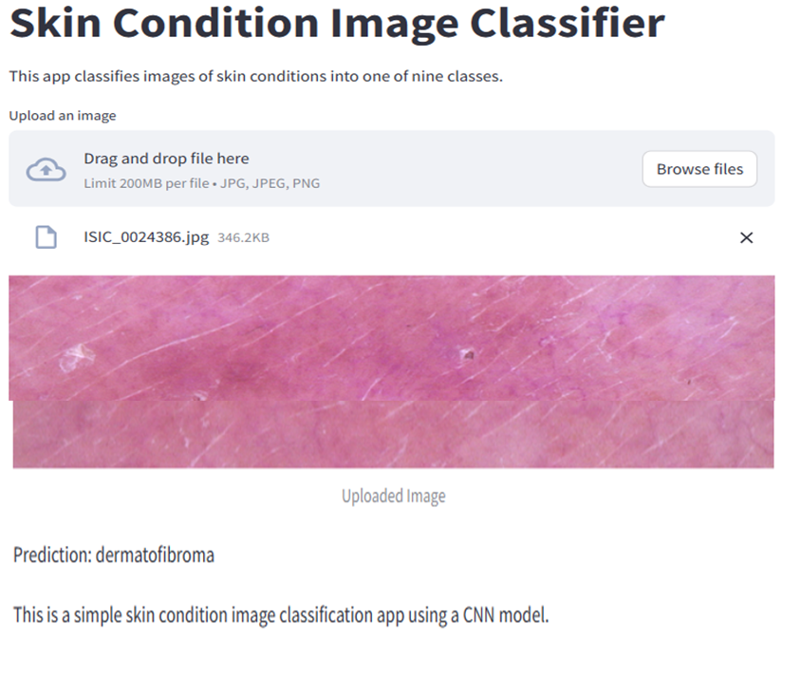
Model Deployment
Model deployment was done using stream lit.
Link to upload images: CNN · Stream lit

Slide 24


